Slide 1
Question mark
Grade - 06 Unit -05
Competency - 02
Competency Level -2.3
Minuwangoda Zonal Education Office.
E igenum Piyasa

Slide 2
Why do we use a question mark?
We use a question mark to end up a question.
Eg: They are at home.
Are they at home?
She is a teacher.
Is she a teacher?
He went in the car.
How did he go?

Slide 3
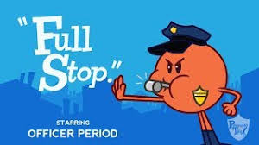
Full stop

Slide 4
Why do we use a full stop?
Show that a sentence has ended.
Eg: Rani is a good girl.
To show an abbreviation has ended.
Eg:This is Mr.Razik.
As a decimal point.
Eg: I had a meeting t 10.30 a.m
He bought a book for Rs.40.00

Slide 5
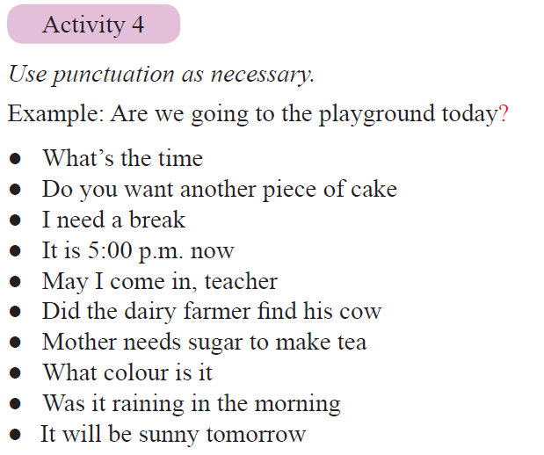

Slide 9
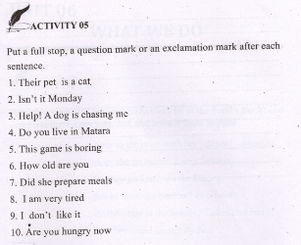
Work book activity 05

Slide 10
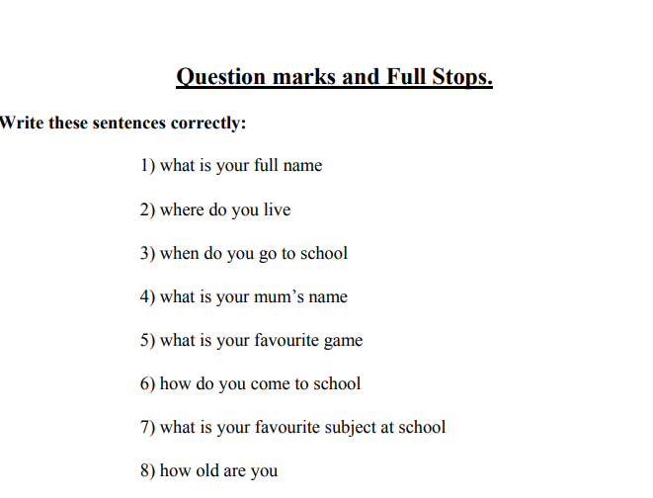
Additional Exercise 01

Slide 11
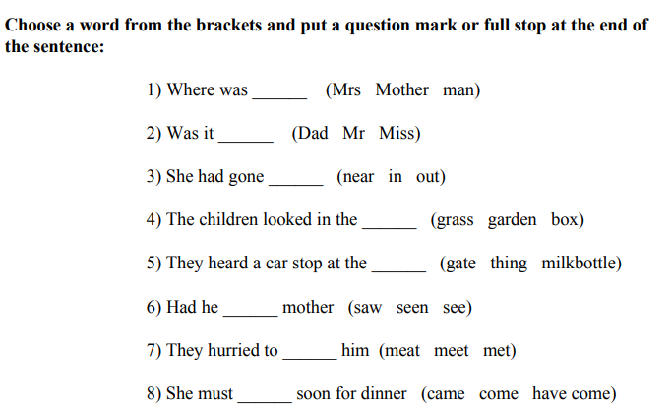
Additional exercise 02

Slide 12
Thank you.

