Slide 1
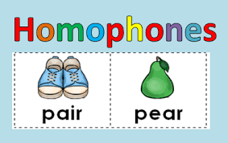
Homophones
Grade -04
Minuwangoda Zonal Education Office
E - Igenum Piyasa

Slide 2
What are homophones?
Homophones are words that sound the same but have different meanings.
Eg: meet - meat
road - rode
their - there
whole - hole
see - sea

Slide 3
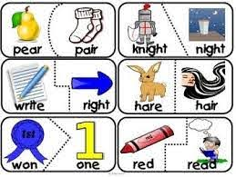

Slide 5
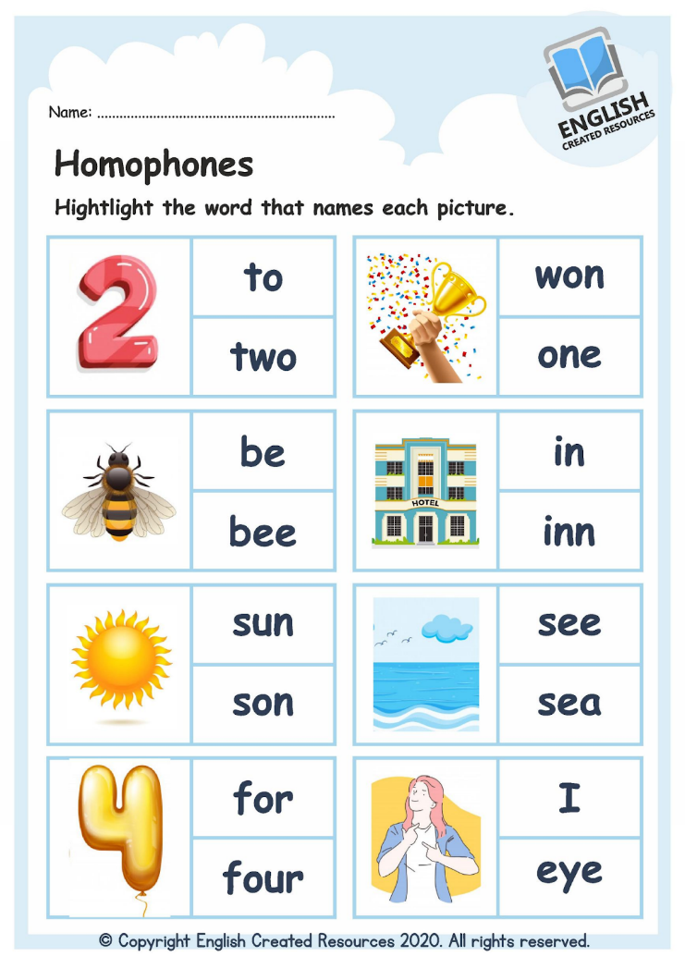

Slide 6
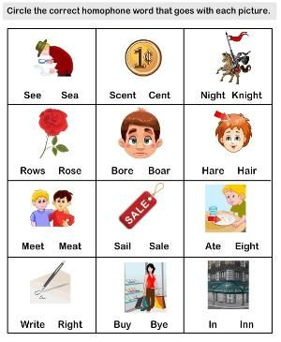

Slide 7
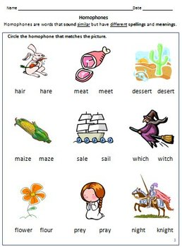

Slide 8
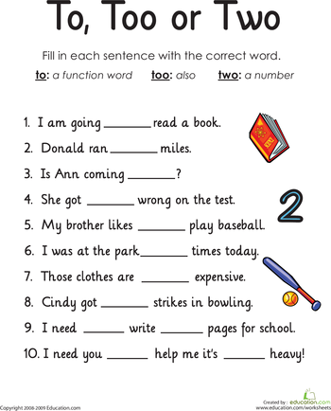

Slide 9
Thank You!

